Slide 1
Sibbir Sihan
Microsoft Certified Data Engineer
NHS Dorset Lead Data Engineer
British Civil Service
American Silicone Valley Software Company
AG: Largest RMG Denim Manufacturer in the world

Slide 2

DATA ENGINEERING
POWER BI DEVELOPMENT
REPORTING ESTATE
Need a way to maintain the data ingestion, cleaning and modelling
A data warehouse where data is finalised for Power Bi Consumption
Maintain Extract, Transform and Load logics
Implementing Slow Changing Dimension in Code to load data into Warehouse
A way to save analytical cost by implementing Kimball Data Model at Warehouse

Slide 3
Data Engineering Architecture
(if you do not have one already)
Lakehouse Architecture
Sandbox
Bronze (Fabric LH)
Silver (Fabric LH)
Gold (Fabric DW)
DATA ENGINEERING
Blob
SQL Servers
ERPs
ADF/
SSIS
Deployment Pipeline (CICD) Git Integration on Azure DevOps YAML Pipeline to call Fabric Rest API to auto deploy from Environments
ETL logics in Notebooks
Notebooks Orchestration in Data Pipeline
Test/Live
Bronze (Fabric LH)
Silver (Fabric LH)
Gold (Fabric DW)
Blob
SQL Servers
ERPs
ADF/
SSIS
ETL logics in Notebooks
Notebooks Orchestration in Data Pipeline

Slide 4
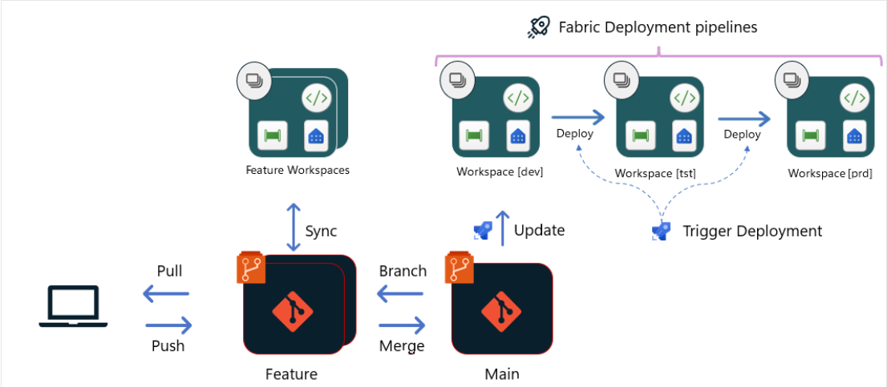
Power BI Development Only
Power BI Development
.pbip
Git Repo
Deployment Pipeline (CICD) Git Integration on Azure DevOps YAML Pipeline to call Fabric Rest API and PowerShell to auto deploy from Git and Stages

Slide 5
MANY ways of implementing a data INFRASTRUCTURE, we just talked about one APPROACH.

